Slide 1
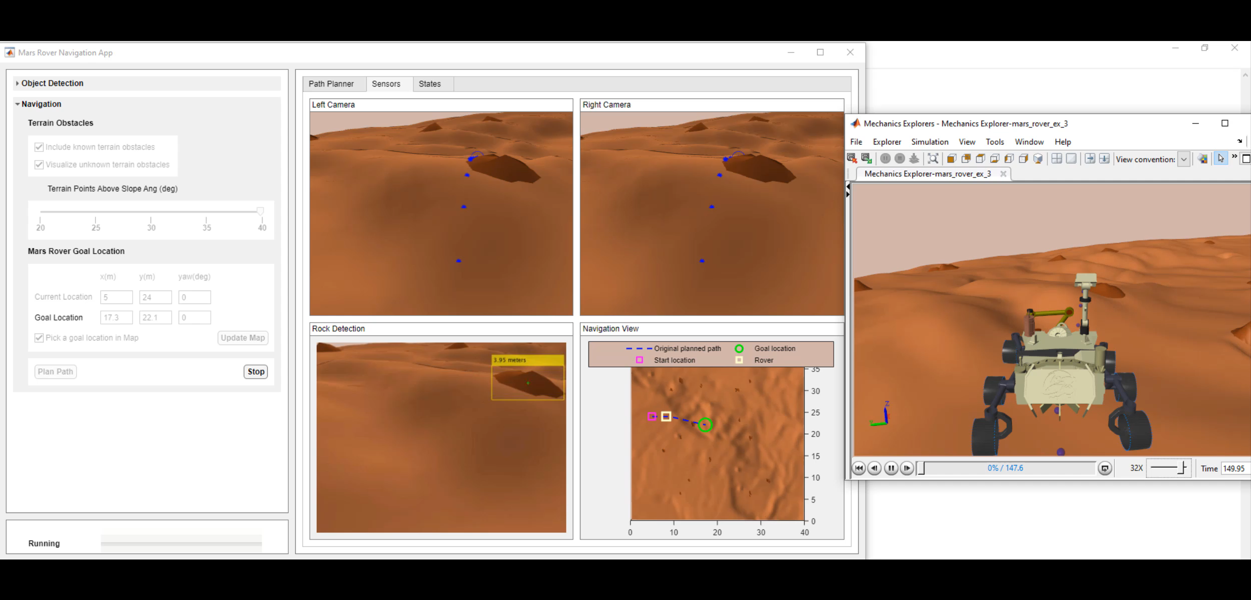
Autonomous Navigation of a Mars Rover
Harshal Upadhyay
Oct 3, 2022

Slide 2
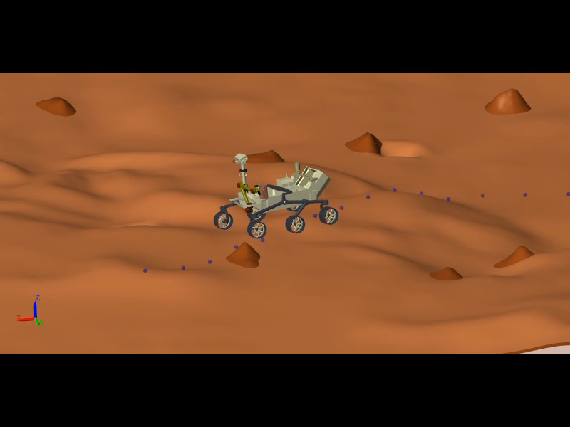
Overview
Motivation:
Develop a workshop around AI/Robotics application for Grace Hopper Celebration conference for 2022 (GHC22)
GHC is the world's largest gathering of women technologists featuring a wide variety of sessions including many trending technical tracks.
Rover Mission:
Rover should reach a chosen goal location on a virtual Martian terrain autonomously and capture a soil sample.
Key Capabilities:
Plan an optimal path based on a known terrain map and some known obstacles.
Once an optimal path is found, rover must navigate the uneven terrain, follow the planned path and reach the desired goal location.
Avoid any unknown rocks on the way.
Use the rover arm to pick up a soil sample

Slide 3
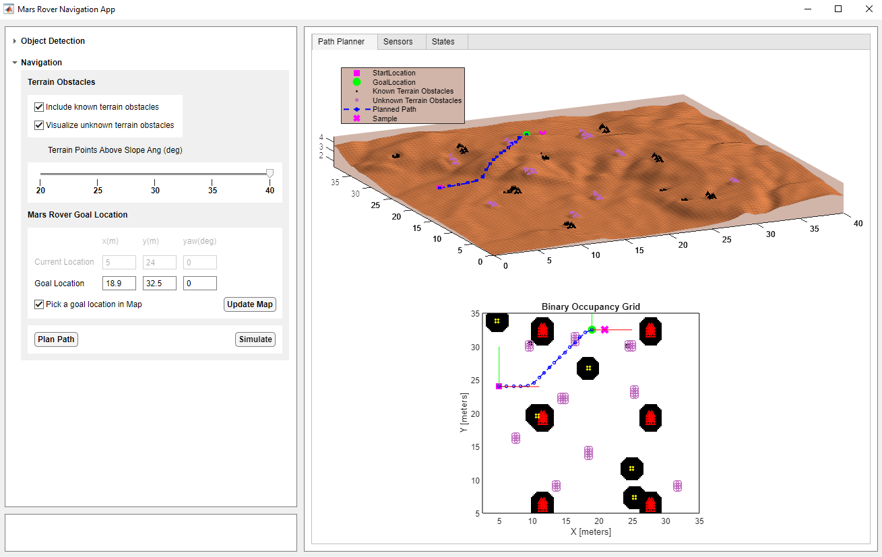
Demo Intro
Mars Rover Navigation App
(MATLAB App)
Path Planning
(Navigation Toolbox)

Slide 4
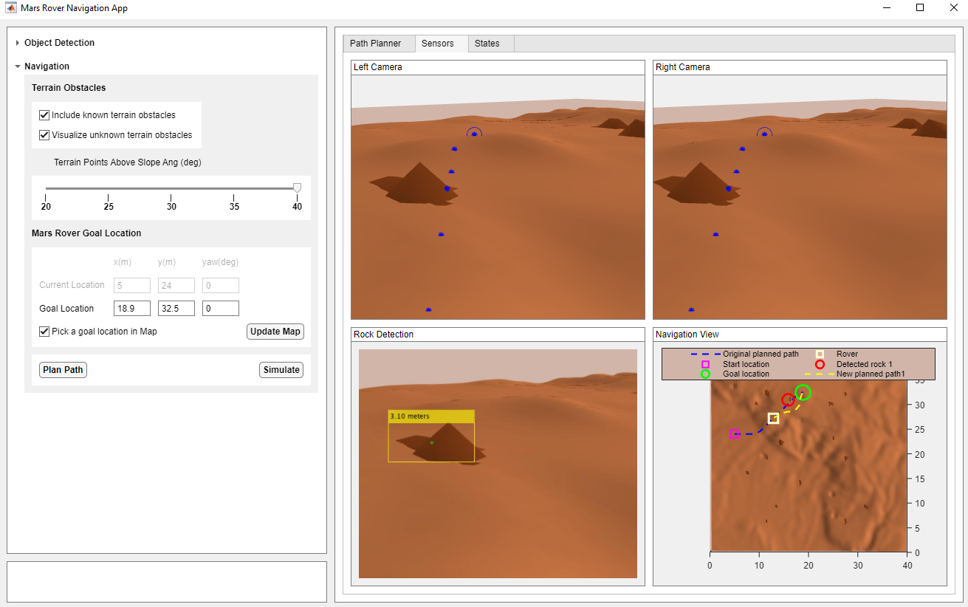
Demo Intro
Camera Sensor
(MATLAB Graphics)
Rock Detection
(Deep Learning)
Obstacle Avoidance

Slide 5
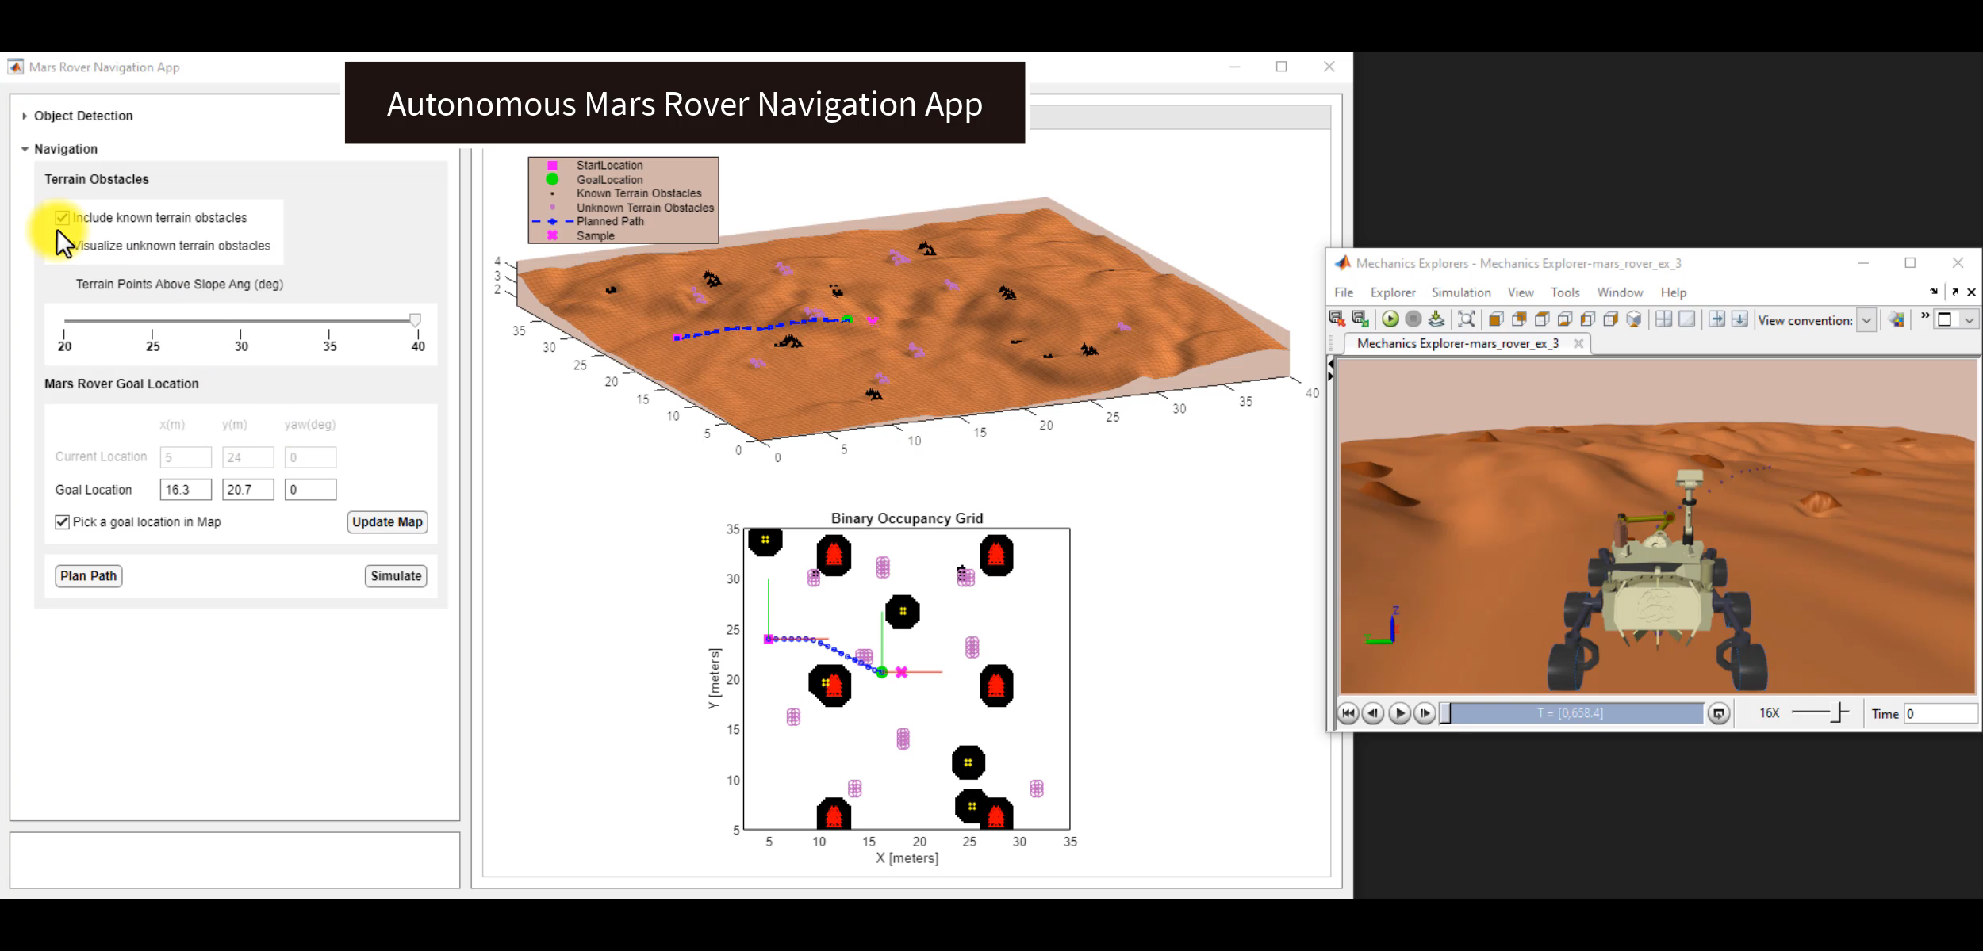

Slide 6
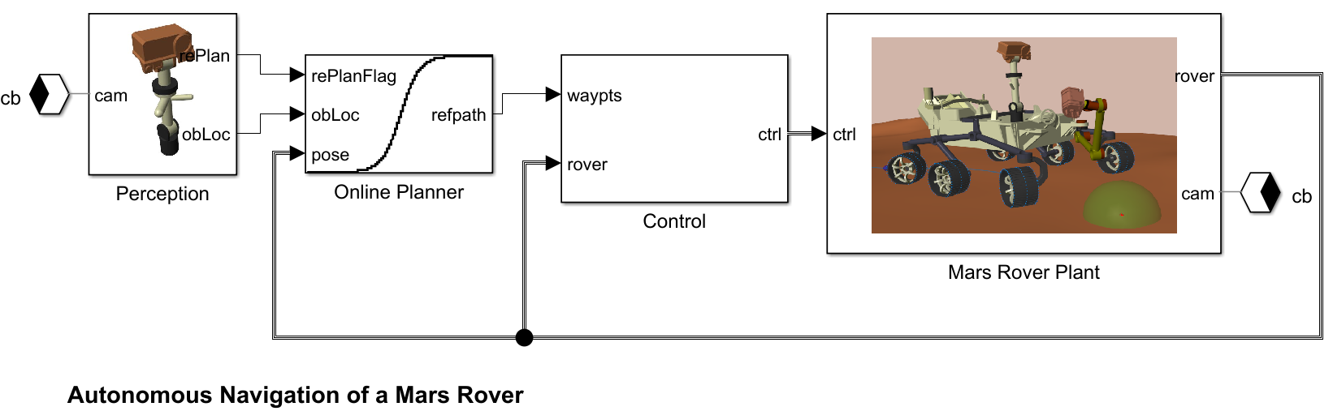
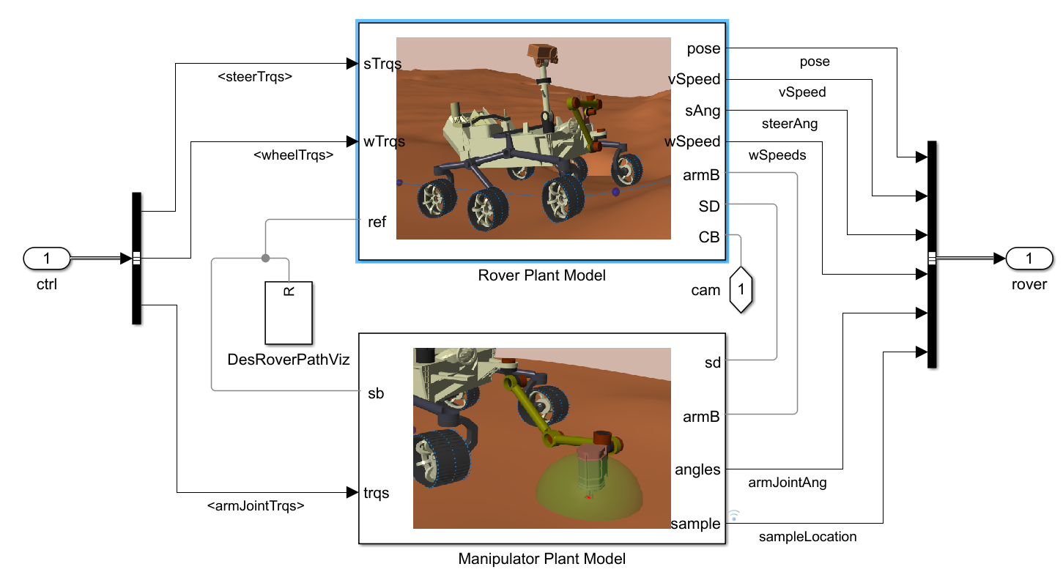
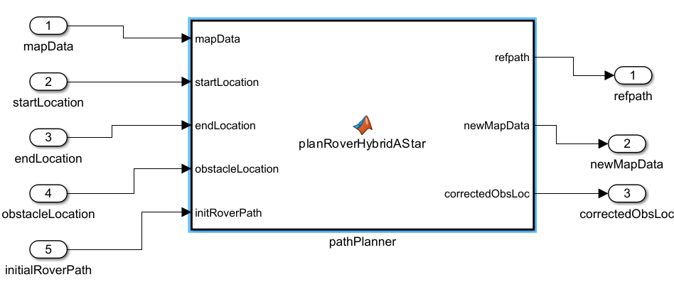
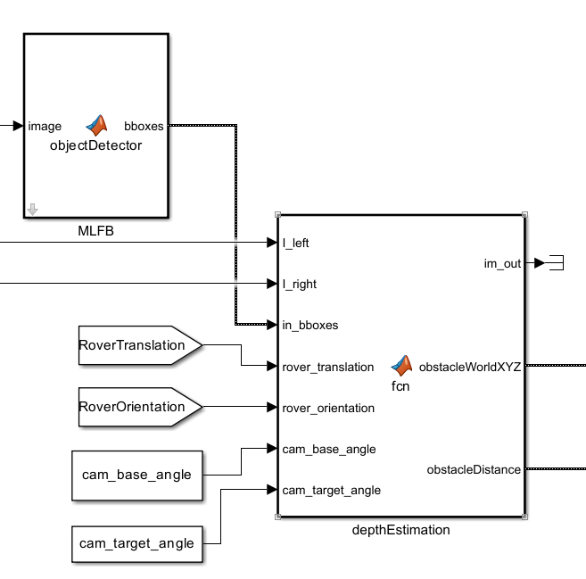
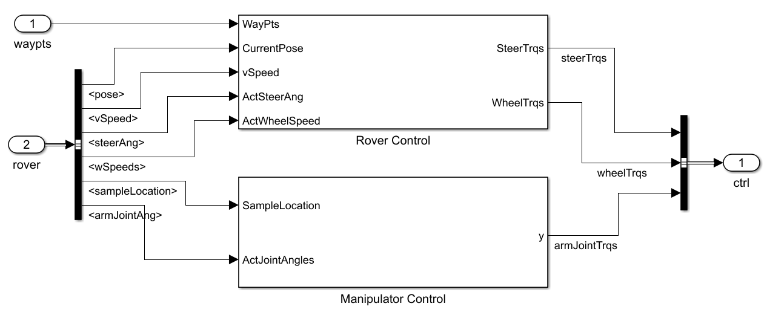
Simulink Model
Object Detector
(DL Toolbox + Image Processing Toolbox)
Obstacle Avoidance
(Navigation Toolbox)
Rover Model
(Simscape Multibody)
Rover and Arm Control
(Robotics System Toolbox + Simscape Multibody)
Rock Depth Estimation
(CV Toolbox)

Slide 7
Rover Model

Slide 8
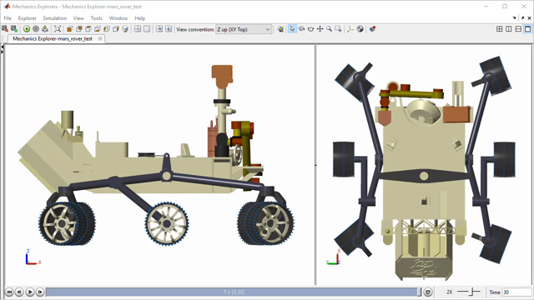
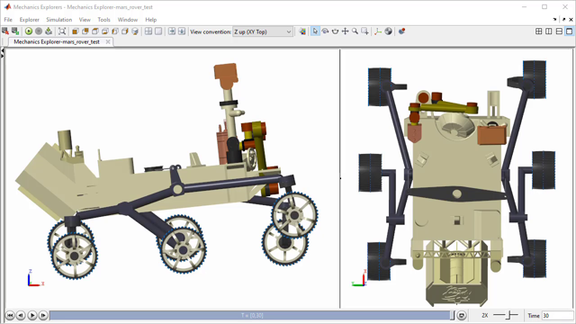
Rover Model
6-wheeled vehicle
6-DOF robotic arm
Rocker bogie suspension
Nav cams – left and right cameras with stereo vision
Ackerman steering
Max velocity ( ~0.1 mph)

Slide 9
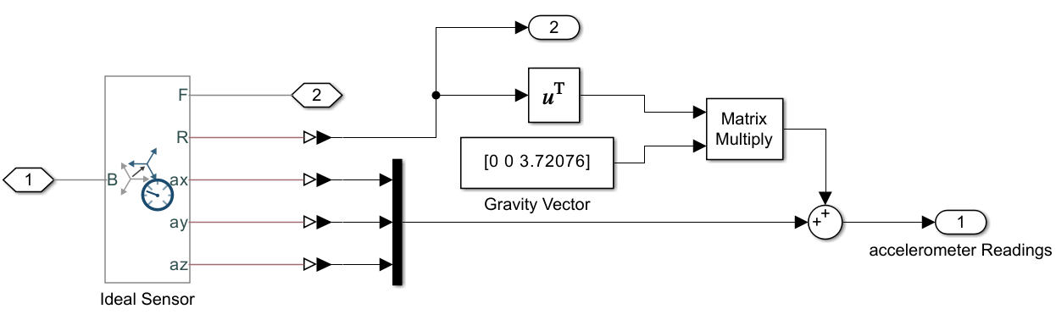
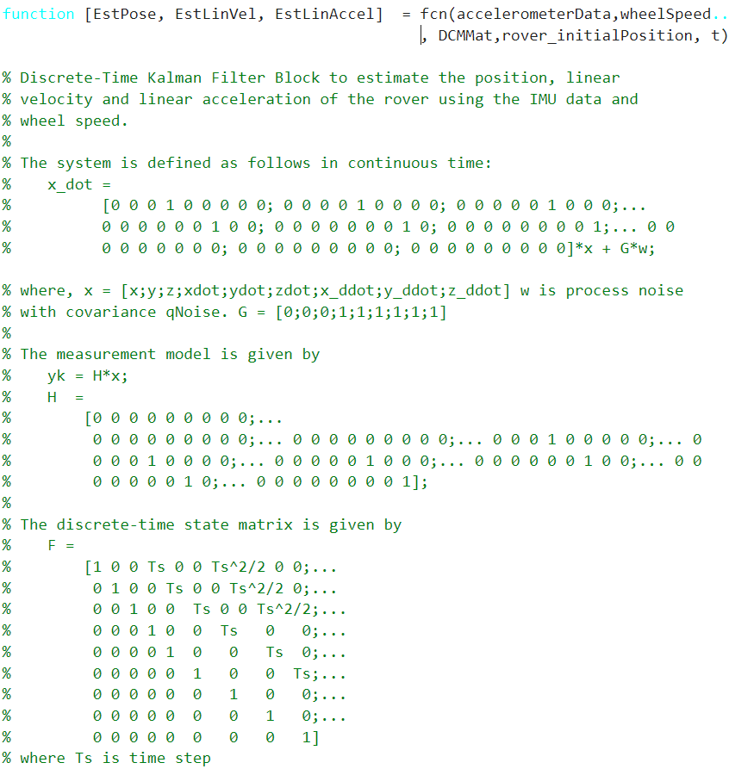
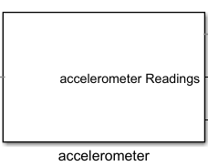
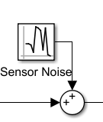
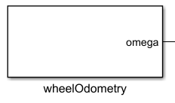
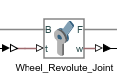
Estimating Rover Position
Kalman Filter for fusing multi-sensor measurement
Rover XY Position
Estimates
Simplified sensor models
Thanks to
Ameya Godbole
Discrete-Time Kalman Filter

Slide 10
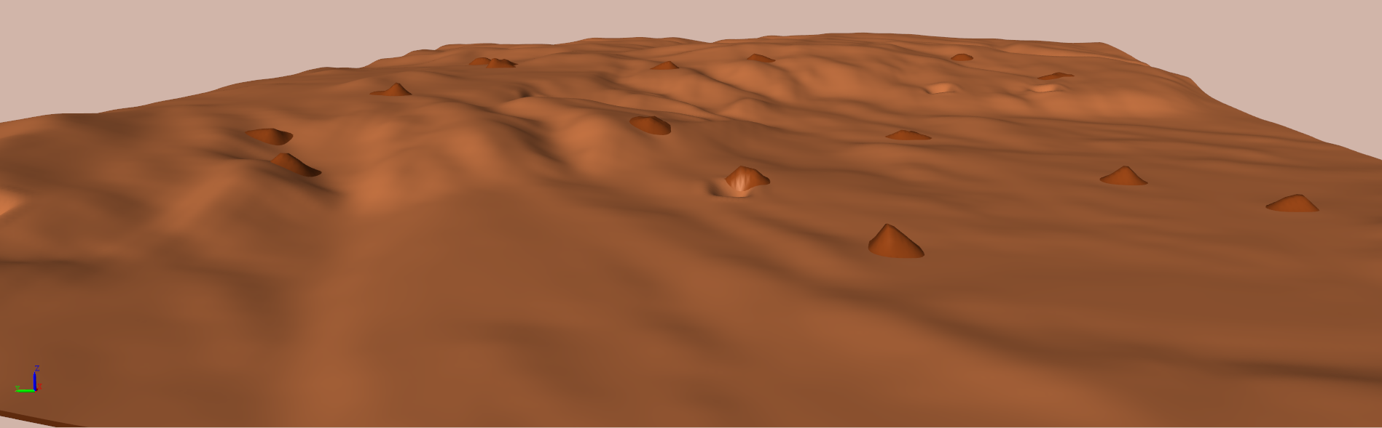
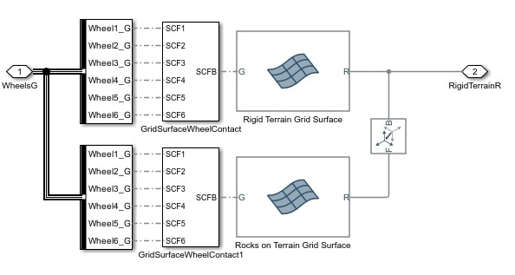
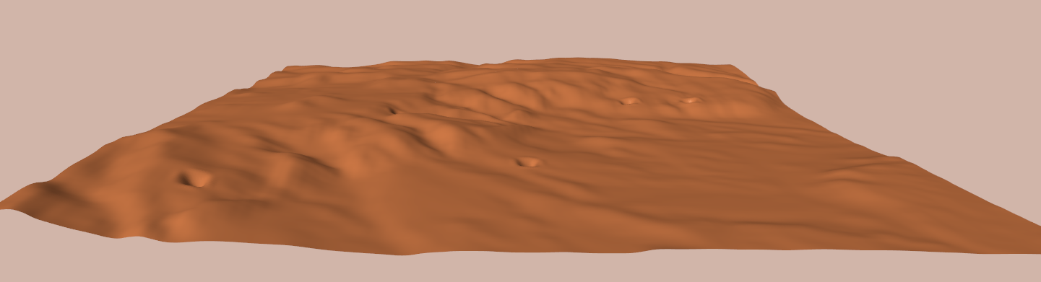
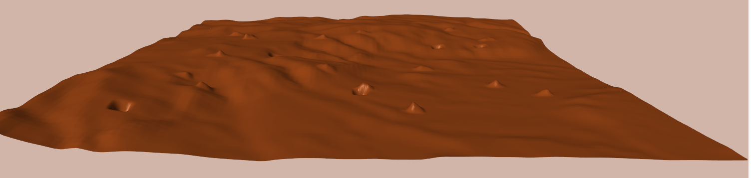
Virtual Mars Terrain
40 x 40 m Map
Steep Terrain
Ditches
Rocks
Contact mechanics with the 6 rover wheels
MATLAB used to get the grid data from STL
Rocks and ditches added manually editing the terrain Z height
Grid surface block

Slide 11
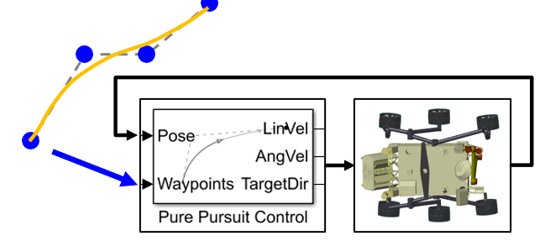
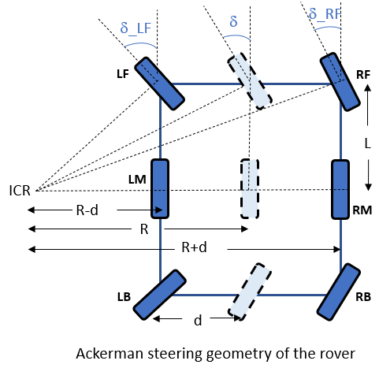
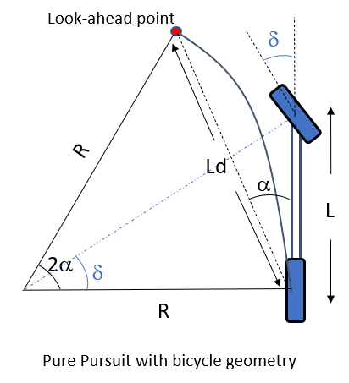
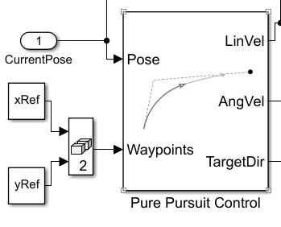
Path Tracking Controller
Desired steering angles
Bicycle steering
angle (δ)
Target direction (α)
Desired chassis
linear velocity
Desired wheel speeds
Look ahead distance
Planar Kinematic Model

Slide 12
Perception Module

Slide 13
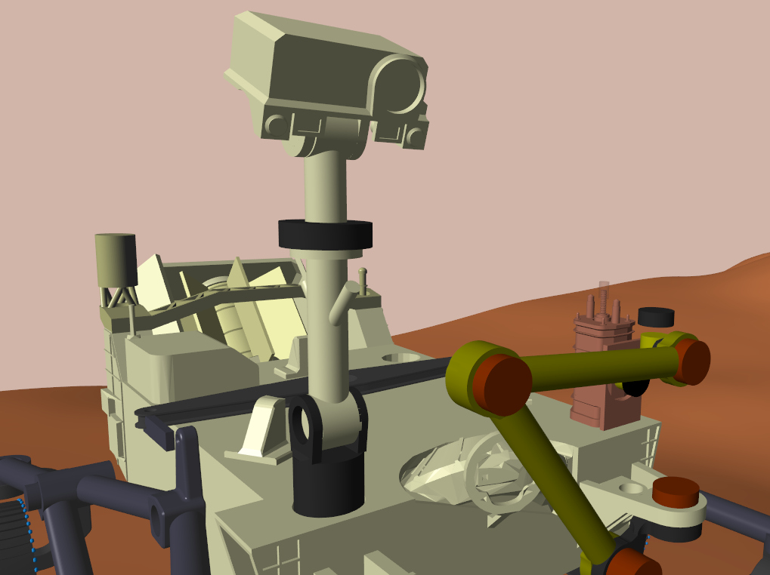
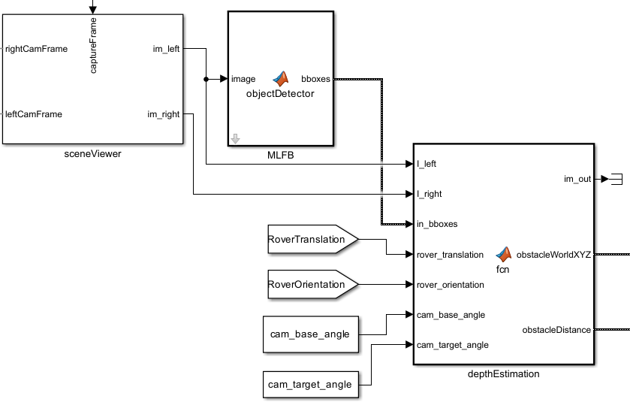
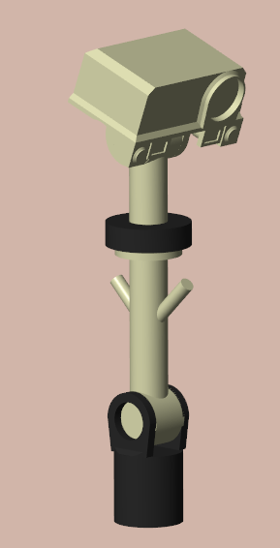
Perception Module : Navigation Cameras
Right Nav Cam
Left Nav Cam
Object Detector
Scene update and image captures
Pitch
Rock Depth Estimation
Pan

Slide 14
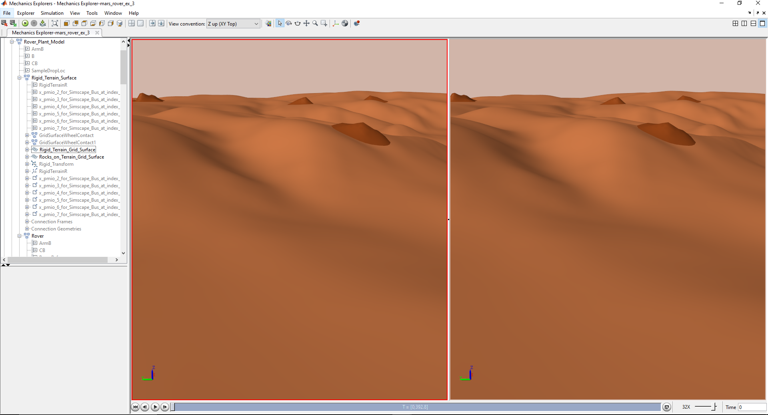
Navigation Cameras : Scene
Left and right camera image frames are needed during simulation for many perception algorithms , like for 3D mapping using stereo vision , for object detection , visual odometry.
Simscape Multibody limitation : It can visualize the view as seen by the cameras but can’t provide the image frames during the simulation for any image processing.
So, what are the options : Unreal engine, Simulink 3D animation.
But this has overhead and probably requires time to setup a scene
Chosen approach : Scene plotting using MATLAB Graphics

Slide 15
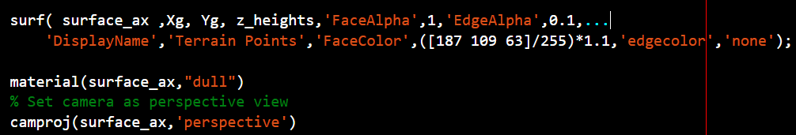
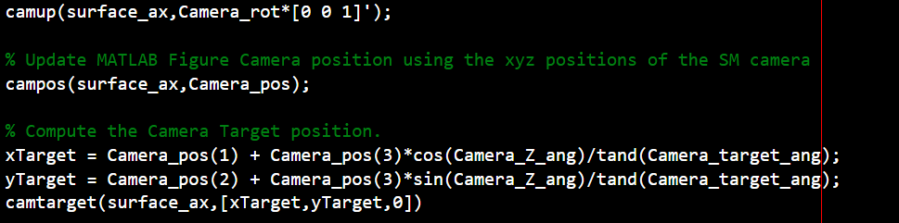
Navigation Cameras : Scene plotting using MATLAB Graphics
Plot terrain using >>surf()
Move the camera within a scene using >>campos
Scene has no moving obstacles for this application
Ease of data transfer between MATLAB and Simulink.
Low overhead

Slide 16
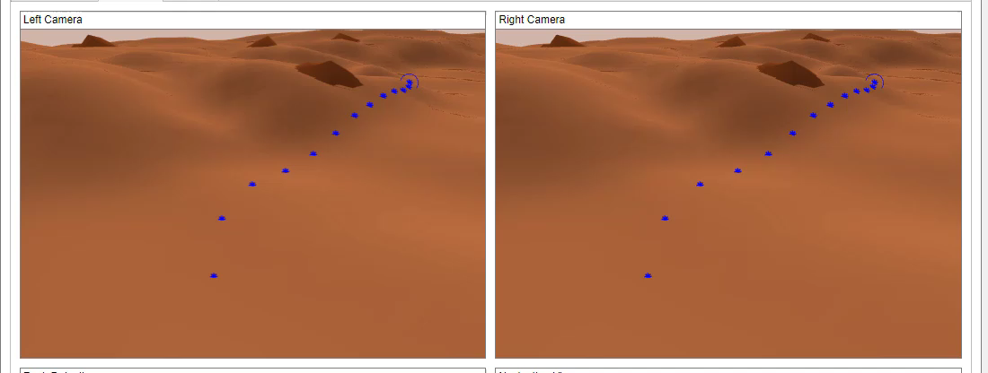
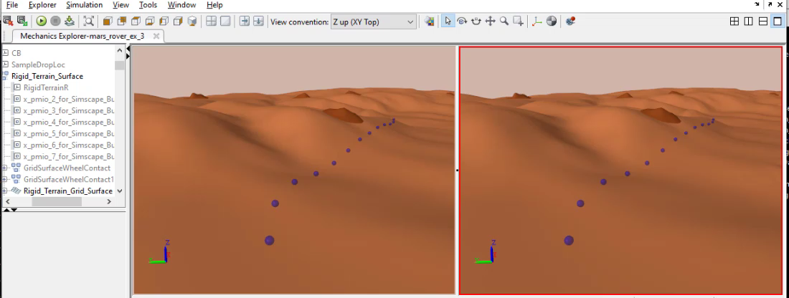
MATLAB Graphics Scene
Mech Explorer

Slide 17



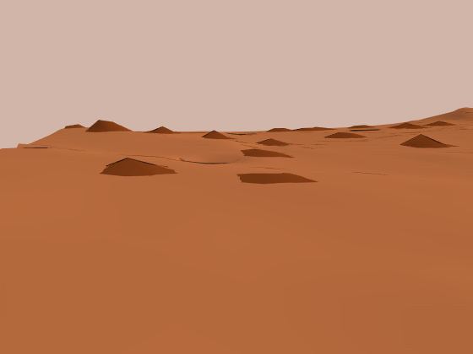
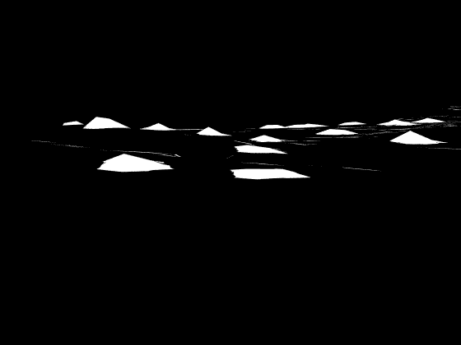
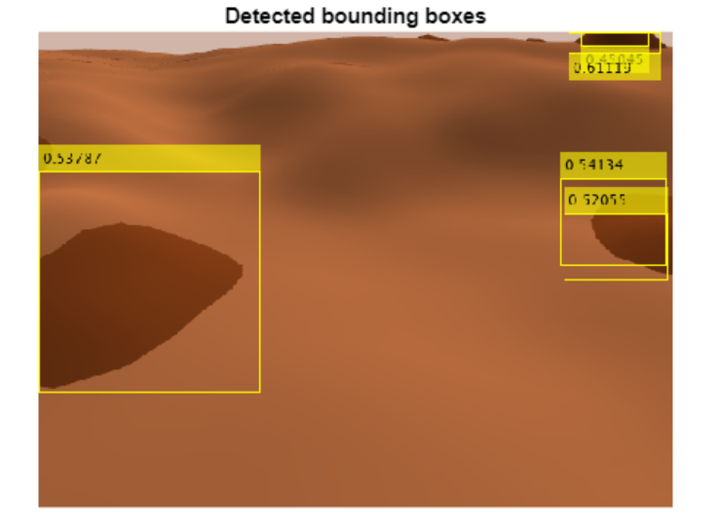
Obstacle Detection using Deep Learning
Preprocessing
Data
Object Detection Network
Train Network
Validate
YOLOv2 : You Only Look Once object detector
>> trainYOLOv2ObjectDetector()
10K training images
Labeled using binary masking
Simscape runtime parameters used to update rover poses , camera pitch and pan angles.
Thanks to Deep Learning QEs :
Antonio Hidalgo and
Gabija Marsalkaite
MATLAB used to automate camera frame captures

Slide 18
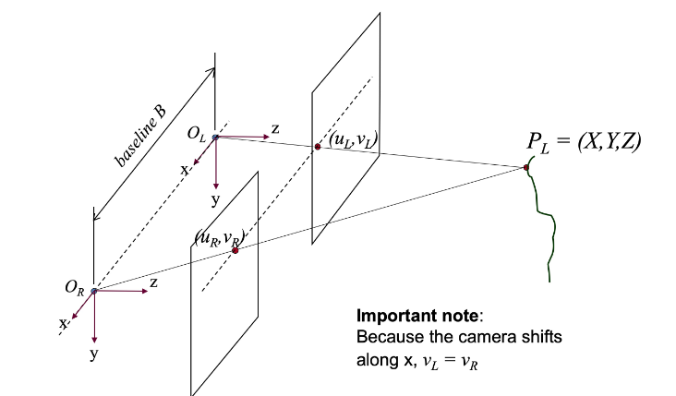
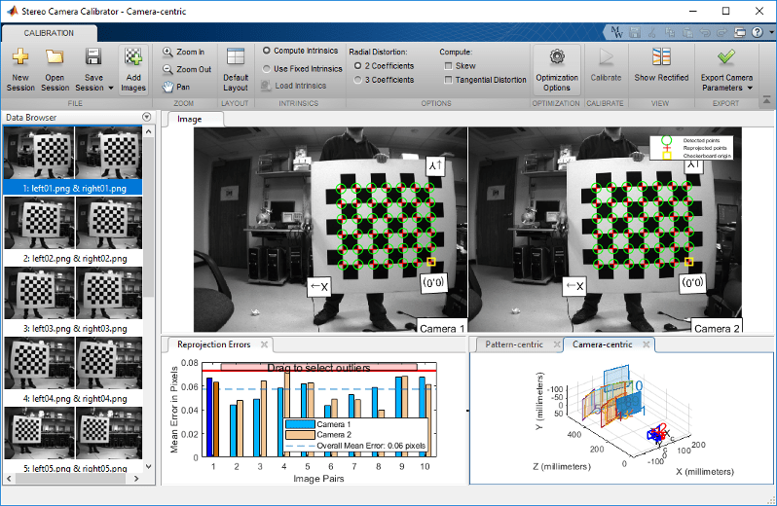
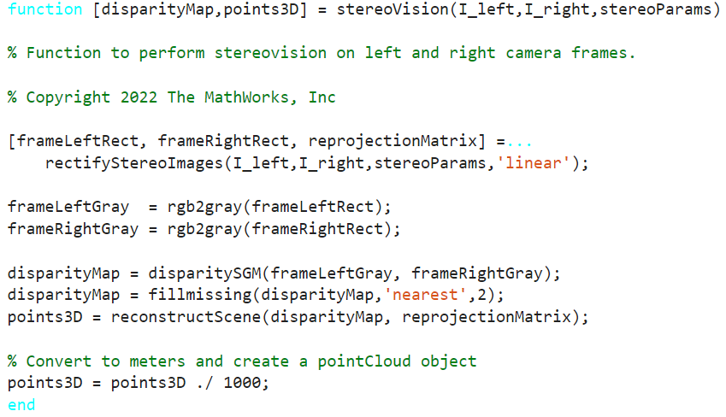
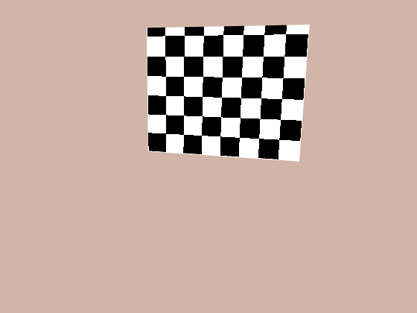
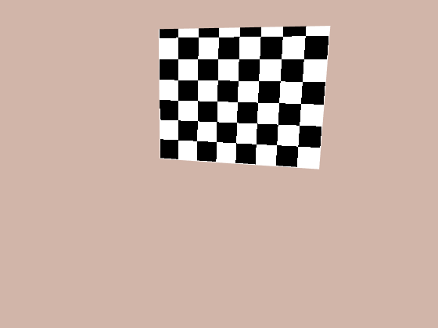
Obstacle Depth Estimation using Stereovision
Stereo vision is the process of extracting 3D information from multiple 2D views of a scene
Stereo Camera Calibration
Disparity Map
Reconstruct 3D scene
Geometric camera calibration, estimates the parameters of a lens like focal length and the distance between 2 stereo cameras etc.
Disparity Map
+
cameraParams
The amount of horizontal distance between the object in image L and image R (the disparity) is inversely proportional to the distance from the observer (depth)
>>stereoCameraCalibrator
Computer Vision Toolbox

Slide 19
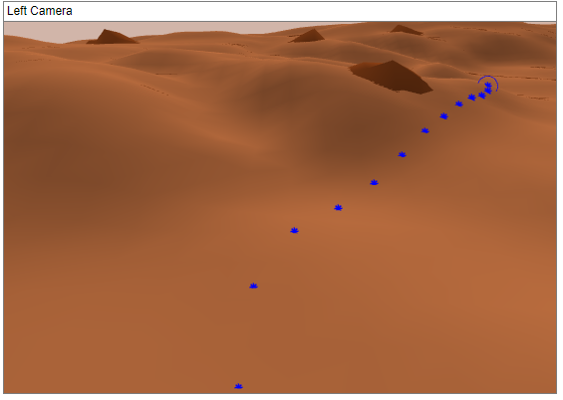
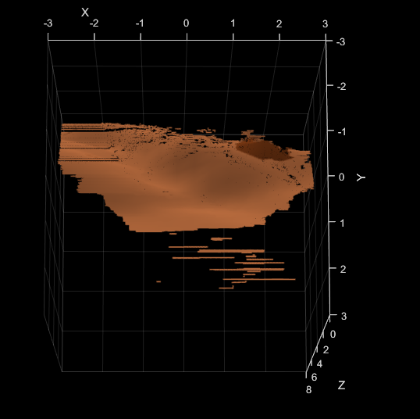
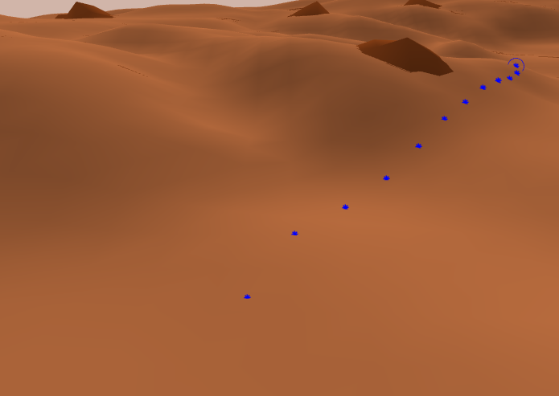
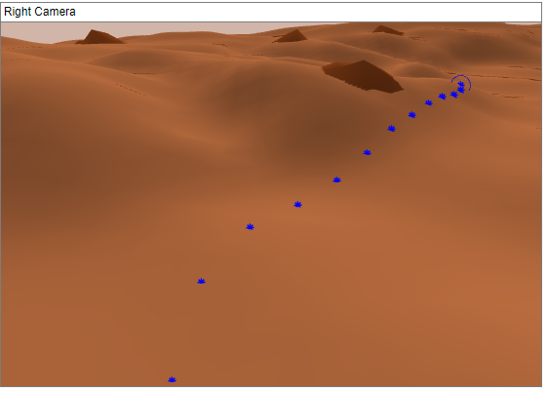
Depth Estimation
6.37 meters
+
Distance of detected rock wrt camera ref frame
Reconstructed scene - 3D point cloud (in camera reference frame)

Slide 20
Path Planning

Slide 21
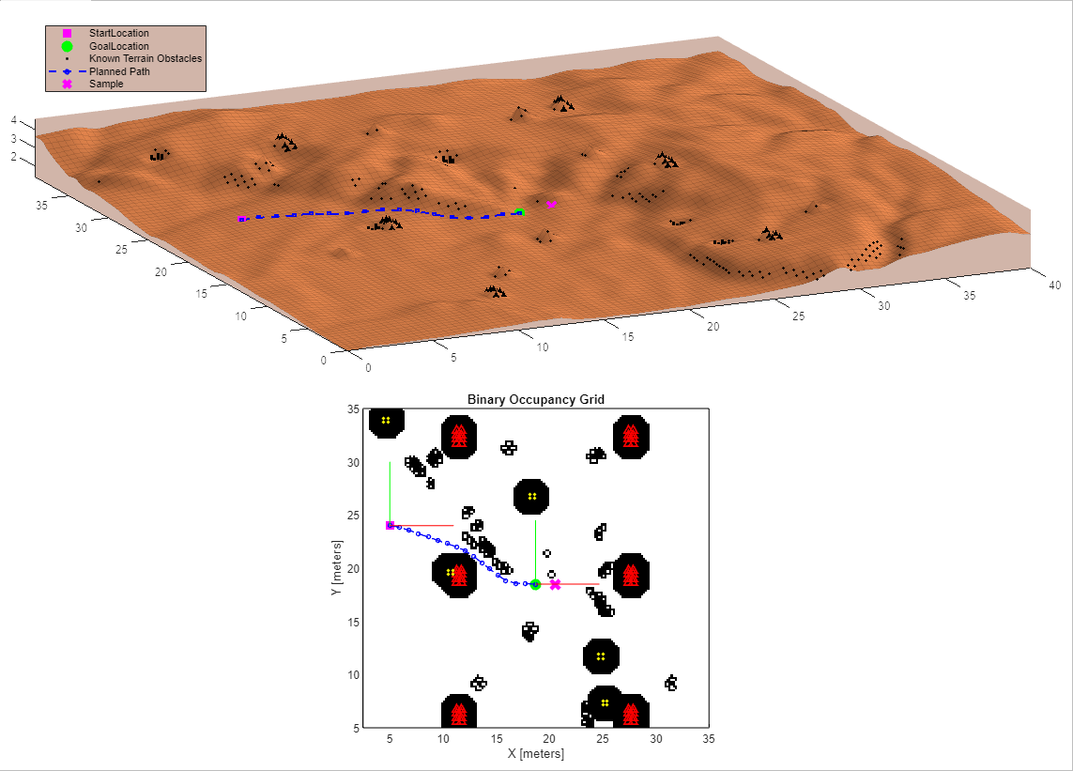
Path Planning : Offline planning
Hybrid A star planner (Nav Toolbox)
Steep terrain points
Hazardous Unknown rock
???
Hazardous ditches
Hazardous known rocks
3D terrain map and some obstacles are assumed to be known using offline mapping / terrain analysis.

Slide 22
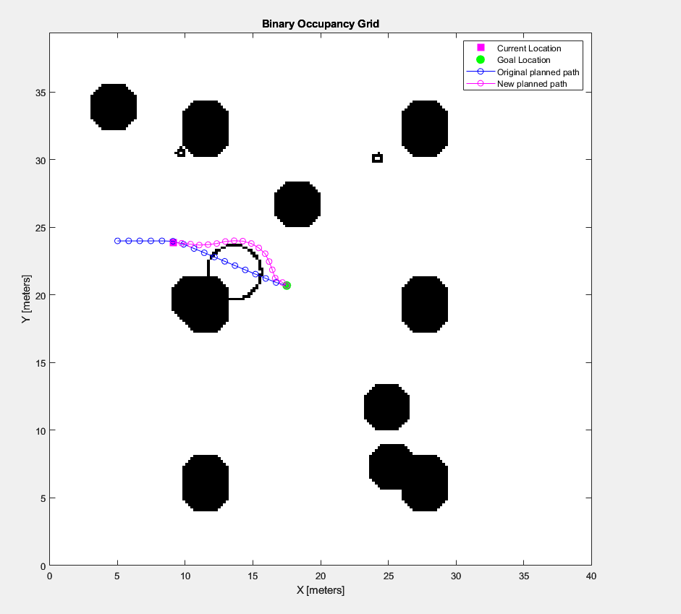
Path Planning : Obstacle avoidance and Online planning
Original Planned Path (using offline planner)
Detect Rocks + Estimate their location w.r.t rover
Trained object (rock) detector + stereovision
Check if any detected rock is on the currently planned path and is less than 3.5 m away
NO
No op
YES
Obstacles known
to the offline planner
Transform location of rock on path to global map
Rock detected on original path
Update obstacle map
Replan from current location to goal location
Using hybrid A star planner

Slide 23
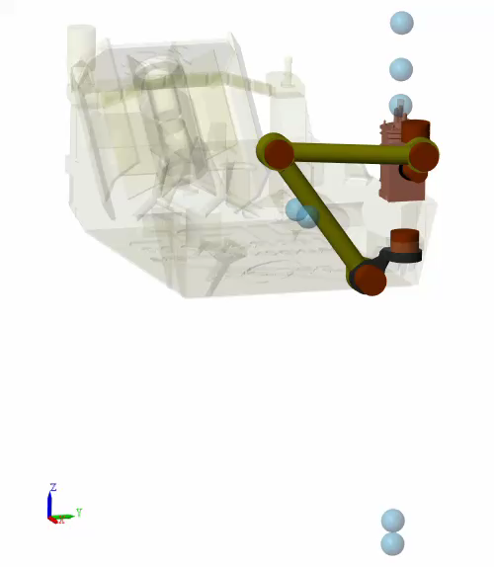
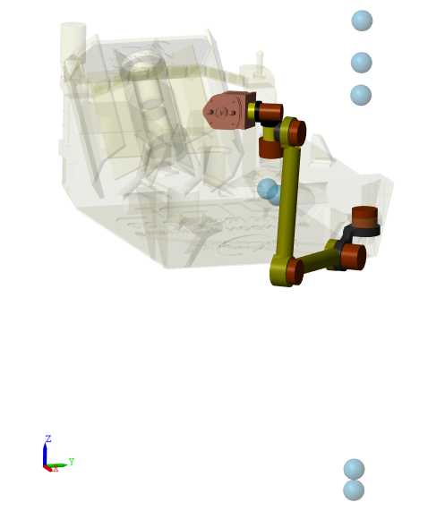


Mars Rover Arm
Drill Tip Waypoints
Sample
Six degrees of freedom
Waypoints define end effector trajectory
Position, orientation relative to arm base
Inverse kinematics used to find joint angles
R6
R4
R1
R5
Trajectory
Joint Angles
R2
R3

Slide 24


Sample Pick Up
Variable Mass blocks for generating a soil sample
Joint Engagement/Disengagement for sample collection

Slide 25


Results

Slide 26

GHC 22 Event
‘AI takes Autonomous Navigation to Mars and Beyond’ workshop
~400 participants
Thanks for your support !
Kritika Ramani (QE)
Maria Gavilan-Alfonso (EduMarketing)
Chinmayi Lanka (QE)
Sara Nambi (Dev)
Ameya Godbole (QE)

Slide 27
Technical Resources
Demo Location : https://insidelabs-git.mathworks.com/hupadhya/autonomous-mars-rover
>> mars_rover_startup;
Rover model details and controls algorithms used:
https://www.mathworks.com/help/sm/ug/mars_rover.html
https://www.mathworks.com/matlabcentral/fileexchange/105700-mars-rover-model-in-simscape/?s_tid=LandingPageTabfx
Pure Pursuit controller : https://www.mathworks.com/help/robotics/ug/pure-pursuit-controller.html
Path planner used:
Hybrid A star planner https://www.mathworks.com/help/nav/ref/plannerhybridastar.html
Deep Learning algorithm used:
Yolov2: https://www.mathworks.com/help/deeplearning/ug/object-detection-using-yolo-v2.html
https://www.mathworks.com/help/vision/ug/getting-started-with-object-detection-using-deep-learning.html
4.Stereo Vision algorithm:
https://www.mathworks.com/help/vision/ug/depth-estimation-from-stereo-video.html
https://www.mathworks.com/help/vision/ug/using-the-stereo-camera-calibrator-app.html
Details regarding how the detector network was constructed/trained - GHC_yolov2.docx

Slide 28
Thank You !

Slide 29

Other useful tricks
Fast restart mode for quick restart of simulation
Update graphics in MATLAB app while Simulink is running by attaching a listener
>> add_exec_event_listener

